Slide 1
Hidden Markov Models

Slide 2
Nucleotide frequencies in the human genome
A | C | T | G
29.5 | 20.4 | 20.5 | 29.6

Slide 3
CpG Islands
Written CpG to distinguish from a C≡G base pair)
CpG dinucleotides are rarer than would be expected from the independent probabilities of C and G.
  Reason: When CpG occurs, C is typically chemically modified by methylation and there is a relatively high chance of methyl-C mutating into T
High CpG frequency may be biologically significant; e.g., may signal promoter region (“start” of a gene).
A CpG island is a region where CpG dinucleotides are much more abundant than elsewhere.

Slide 4
Hidden Markov Models
Components:
  Observed variables
    Emitted symbols
  Hidden variables
  Relationships between them
    Represented by a graph with transition probabilities
Goal: Find the most likely explanation for the observed variables

Slide 5
The occasionally dishonest casino
A casino uses a fair die most of the time, but occasionally switches to a loaded one
  Fair die: Prob(1) = Prob(2) = . . . = Prob(6) = 1/6
  Loaded die: Prob(1) = Prob(2) = . . . = Prob(5) = 1/10, Prob(6) = ½
  These are the emission probabilities
Transition probabilities
  Prob(Fair → Loaded) = 0.01
  Prob(Loaded → Fair) = 0.2
  Transitions between states obey a Markov process

Slide 6
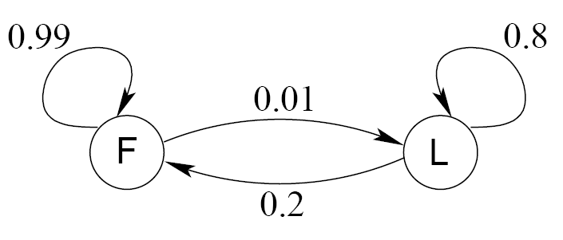
An HMM for the occasionally dishonest casino
0.95
0.05

Slide 7
The occasionally dishonest casino
Known:
  The structure of the model
  The transition probabilities
Hidden: What the casino did
  FFFFFLLLLLLLFFFF...
Observable: The series of die tosses
  3415256664666153...
What we must infer:
  When was a fair die used?
  When was a loaded one used?
    The answer is a sequence
    FFFFFFFLLLLLLFFF...

Slide 8
Making the inference
Model assigns a probability to each explanation of the observation:
P(326|FFL)
= P(3|F)·P(F→F)·P(2|F)·P(F→L)·P(6|L)
= 1/6 · 0.99 · 1/6 · 0.01 · ½
Maximum Likelihood: Determine which explanation is most likely
  Find the path most likely to have produced the observed sequence
Total probability: Determine probability that observed sequence was produced by the HMM
  Consider all paths that could have produced the observed sequence

Slide 9
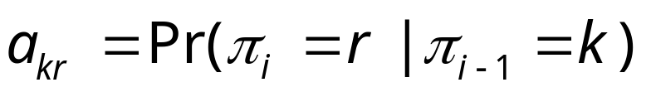
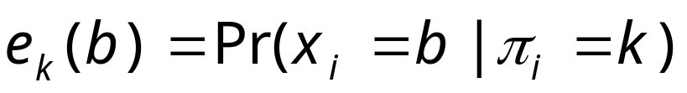
Notation
x is the sequence of symbols emitted by model
  x_{i} is the symbol emitted at time i
A path, π, is a sequence of states
  The i-th state in π is π_{i}
a_{kr} is the probability of making a transition from state k to state r:
e_{k}(b) is the probability that symbol b is emitted when in state k

Slide 10
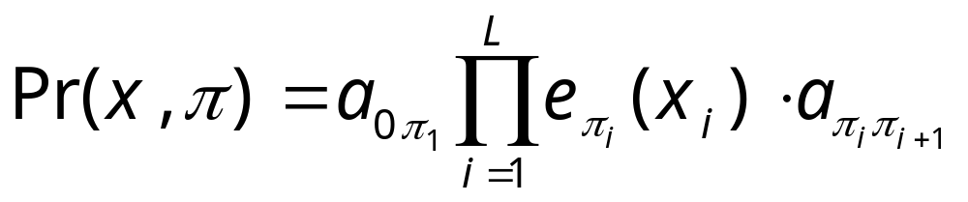
A “parse” of a sequence
1
1
1
1
…
1
2
2
2
2
2
…
2
0
0
…
…
…
…
K
K
K
K
…
K
x₁
x₂
x₃
x_{L}

Slide 11
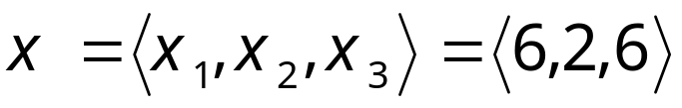
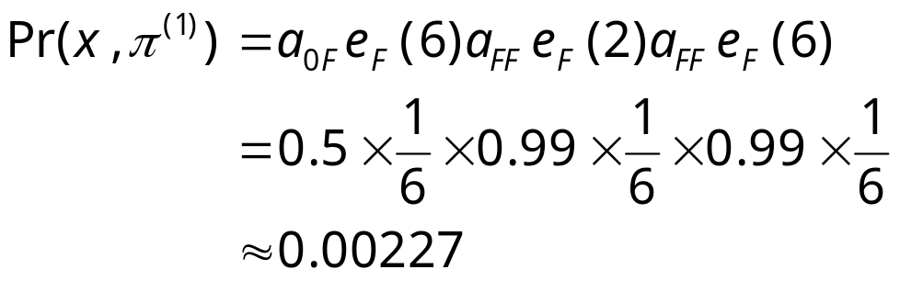


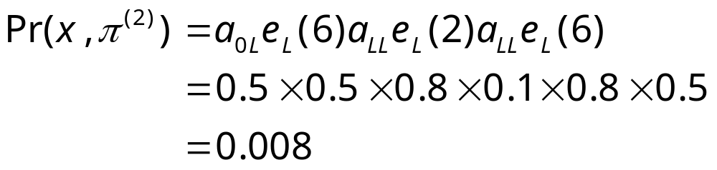

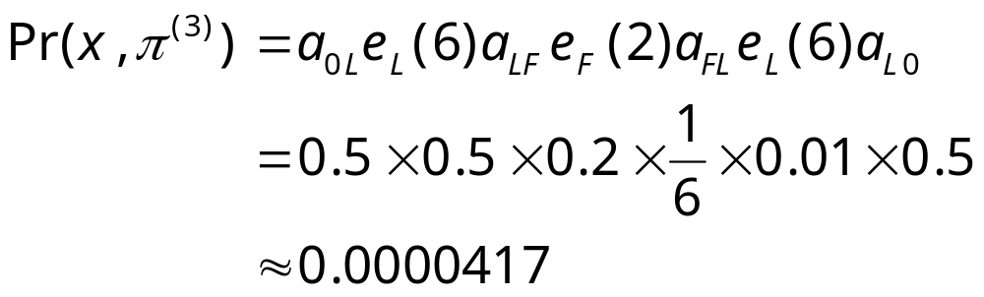

The occasionally dishonest casino

Slide 12
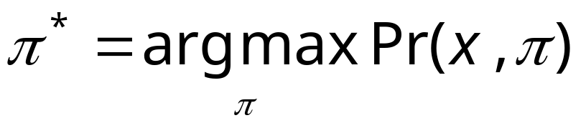
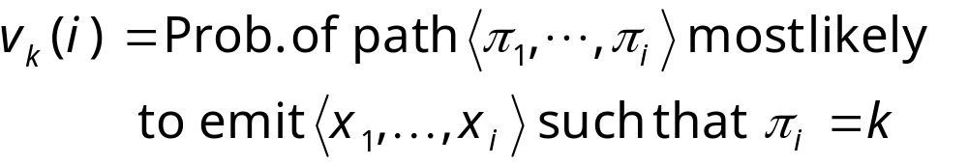
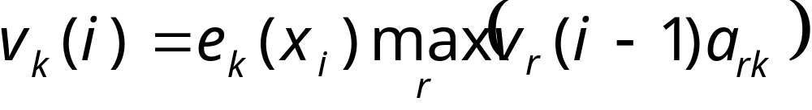
The most probable path
The most likely path π* satisfies
To find π*, consider all possible ways the last symbol of x could have been emitted
Let
Then

Slide 13
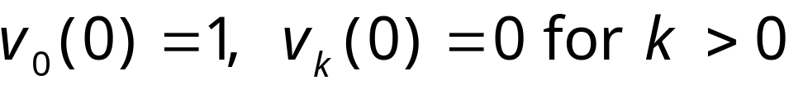

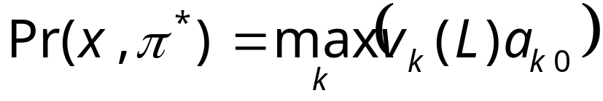
The Viterbi Algorithm
Initialization (i = 0)
Recursion (i = 1, . . . , L): For each state k
Termination:
To find π*, use trace-back, as in dynamic programming

Slide 14
Viterbi: Example
x
ε
6
2
6
B
1
0
0
0
(1/6)×(1/2)
= 1/12
(1/6)×max{(1/12)×0.99,
(1/4)×0.2}
= 0.01375
(1/6)×max{0.01375×0.99,
0.02×0.2}
= 0.00226875
π
F
0
(1/2)×(1/2)
= 1/4
(1/10)×max{(1/12)×0.01,
(1/4)×0.8}
= 0.02
(1/2)×max{0.01375×0.01,
0.02×0.8}
= 0.08
L
0

Slide 15
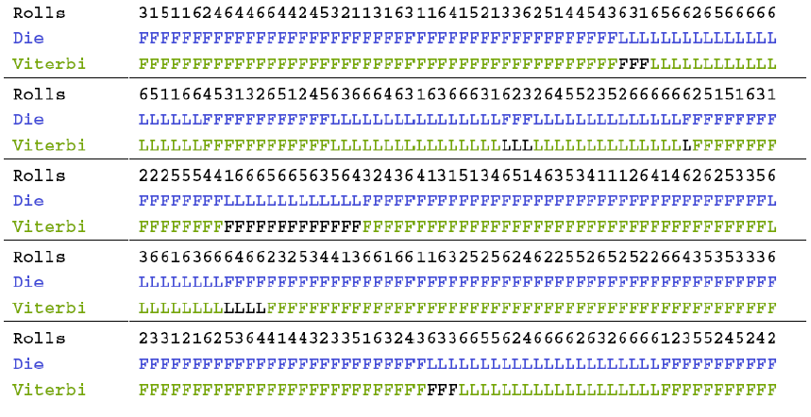
Viterbi gets it right more often than not

Slide 16
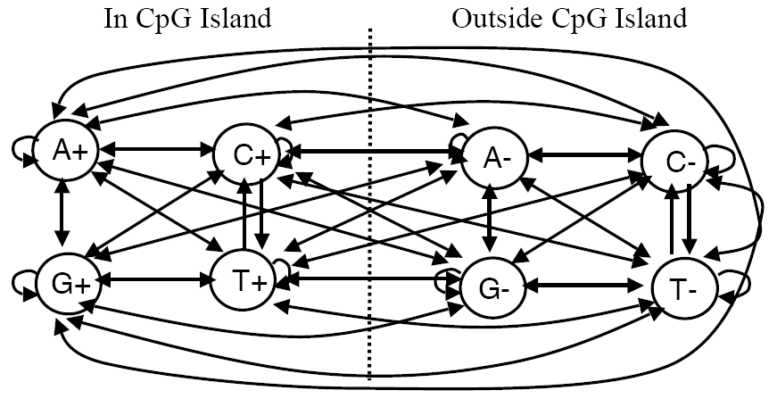
An HMM for CpG islands
Emission probabilities are 0 or 1. E.g. e_{G-}(G) = 1, e_{G-}(T) = 0
See Durbin et al., Biological Sequence Analysis,. Cambridge 1998

Slide 17
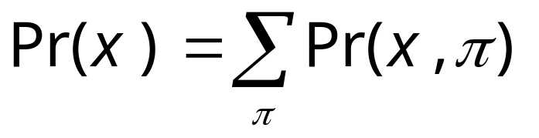
Total probabilty
Many different paths can result in observation x.
The probability that our model will emit x is
Total Probability
If HMM models a family of objects, we want total probability to peak at members of the family. (Training)

Slide 18
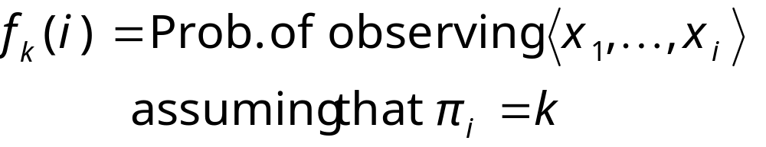
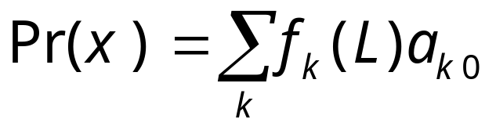
Total probabilty
Pr(x) can be computed in the same way as probability of most likely path.
Let
Then
f
(
i
)
=
e
(
x
)
∑
f
(
i
−
1
)
a
k
k
i
r
rk
r
and

Slide 19
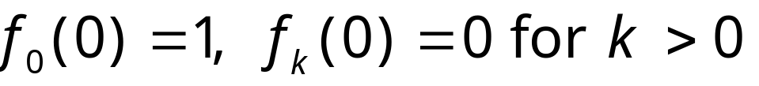
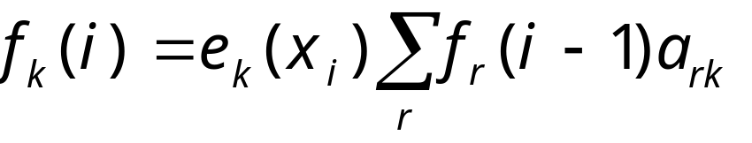
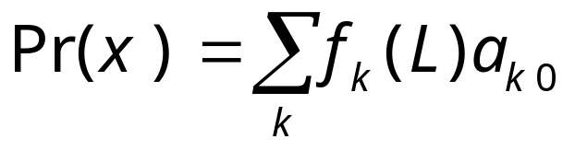
The Forward Algorithm
Initialization (i = 0)
Recursion (i = 1, . . . , L): For each state k
Termination:

Slide 20
Estimating the probabilities (“training”)
Baum-Welch algorithm
  Start with initial guess at transition probabilities
  Refine guess to improve the total probability of the training data in each step
    May get stuck at local optimum
  Special case of expectation-maximization (EM) algorithm
Viterbi training
  Derive probable paths for training data using Viterbi algorithm
  Re-estimate transition probabilities based on Viterbi path
  Iterate until paths stop changing

Slide 21
Profile HMMs
Model a family of sequences
Derived from a multiple alignment of the family
Transition and emission probabilities are position-specific
Set parameters of model so that total probability peaks at members of family
Sequences can be tested for membership in family using Viterbi algorithm to match against profile

Slide 22
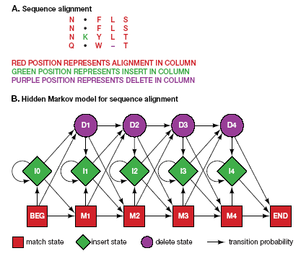
Profile HMMs

Slide 23
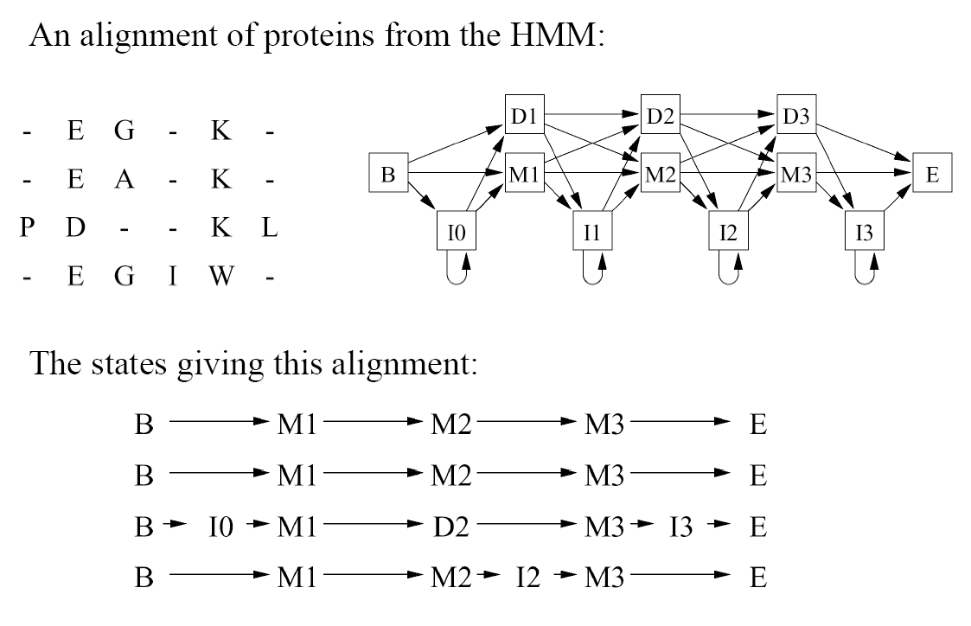
Profile HMMs: Example
Note: These sequences could lead to other paths.
Source: http://www.csit.fsu.edu/~swofford/bioinformatics_spring05/

Slide 24
Pfam
“A comprehensive collection of protein domains and families, with a range of well-established uses including genome annotation.”
Each family is represented by two multiple sequence alignments and two profile-Hidden Markov Models (profile-HMMs).
A. Bateman et al. Nucleic Acids Research (2004) Database Issue 32:D138-D141 _x000b_

Slide 25
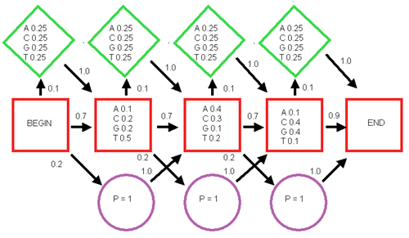
Lab 5
I₁
I₂
I₃
I₄
M₁
M₂
M₃
D₁
D₂
D₃

Slide 26
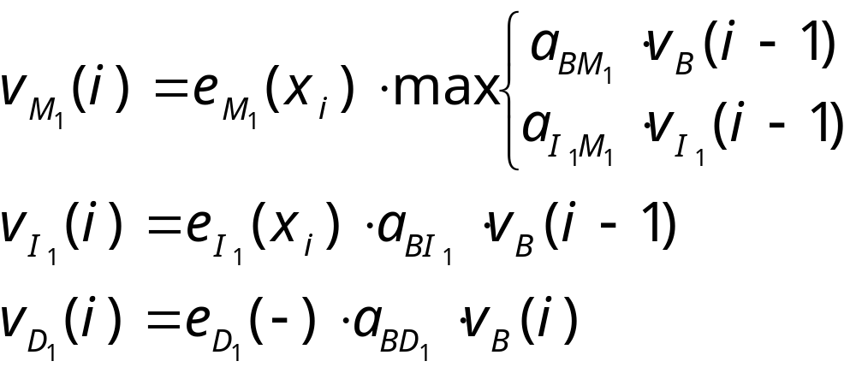
Some recurrences
I₁
I₂
I₃
I₄
M₁
M₂
M₃
D₁
D₂
D₃

Slide 27
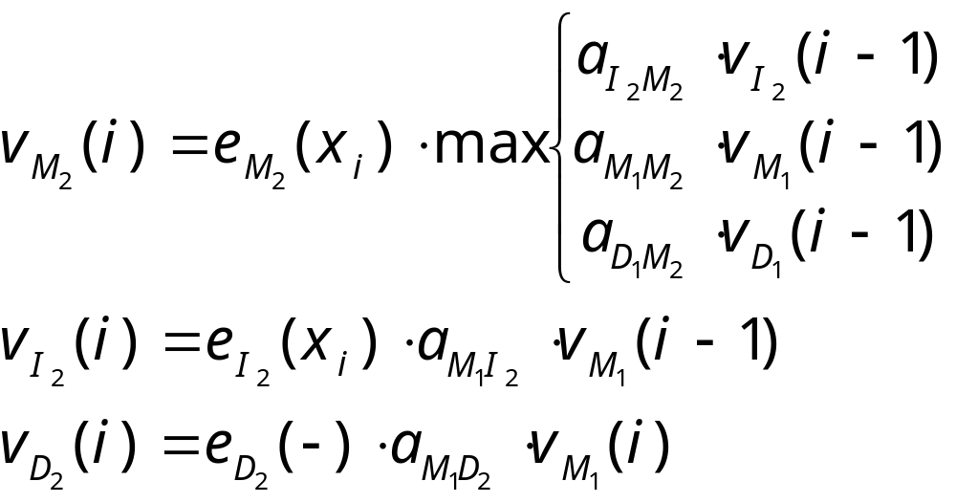
More recurrences
I₁
I₂
I₃
I₄
M₁
M₂
M₃
D₁
D₂
D₃

Slide 28
 | ε | T | A | G | ε
Begin | 1 | 0 | 0 | 0 | 0
M₁ | 0 | 0.35
M₂ | 0 | 0.04
M₃ | 0 | 0
I₁ | 0 | 0.025
I₂ | 0 | 0
I₃ | 0 | 0
I₄ | 0 | 0
D₁ | 0.2 | 0
D₂ | 0 | 0.07
D₃ | 0 | 0
End | 0 | 0

